Slide 1
Notes:
Copyright 2005, Eric Dombach, Business Action, Inc. DBA The Coaches' Coach

Slide 2
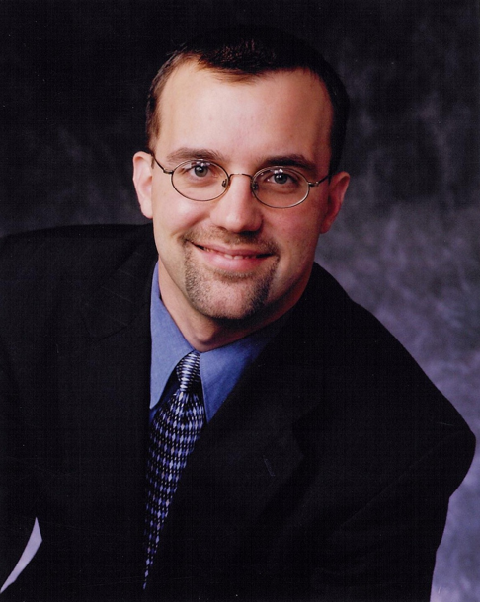
3
Most Important Things
To Know About Your
Business Advisor
Eric Dombach
1
Award-Winning Business & Executive Coach
Professional business and executive coach to more than 140 privately held companies on 5 continents over the last 12 years. Founded a business and executive coaching firm comprised of 7 business coaching franchise units delivering $1 million+ USD in revenue, 23% operating profit, and average annual growth rate of 140% per year. Executed a regional marketing strategy, implemented CRM system and sales process, developed a proprietary service-delivery methodology, and recruited local executive leadership talent to service clients. Sold the firm to employees for 7-figures and an 800% return on capital. Received the 2005 International Franchising Association, Franchisee of the Year Award (www.franchise.org) Has trained more than 1,300 independent and franchised business coaches in the United States, Canada, Mexico, Europe, and Australasian markets in his trademarked business coaching system, The 5 Steps to Business Freedom™ and The 21 Silver Bullets™. Has published hundreds of industry articles, white papers, and books, including The Million Dollar Business Coaching Firm on Amazon.
2
Seasoned Entrepreneur and Business Building Executive
Founder of STEAM Online Marketing, a digital marketing agency with 6 U.S. based managers and more than 40 contractors servicing small to mid-sized companies on three continents. Delivered $500,000 in sales in the company’s first year with no debt, no outside investment, and a 13% distribution of operating profit to the co-founders in year one. In 1.5 years, turned around a failing franchise brand for a national, multi-brand franchisor. Drove franchisee failure rate from 57% down to 4% within 18 months and grew active units from 13 to 41. Delivered $1,500,000 USD of regional development and franchise awards in North America and Europe, a 222% increase.
3
Husband, Father, Scholar, and Hobbyist
Happily married to Deborah with whom he is raising four children: Jeremiah, Hannah, Judah, and Josiah. BS in Electrical Engineering from Messiah College. MBA in process with a concentration in Organizational Leadership and International Finance. Voracious reader of titles on business leadership, management, investing, real estate, politics, economics, theology, philosophy, and spirituality. Avid composer and music lover. Leader of a local, gigging jazz-fusion band. Enjoys running and eating!
Schedule Your FREE “Business Growth Consultation”
Today!
eric@myprofitrocket.com +1 (717) 201.5579
Notes:
Copyright 2005, Eric Dombach, Business Action, Inc. DBA The Coaches' Coach

Slide 3
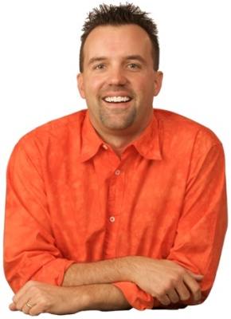
4
Most Important Things
To Know About Your
Business Coach:
Eric Dombach
Eric Dombach
1
Founder and President of The Coaches’ Coach. (2005 to Present)
Has trained over 1300 business coaches in the United States, Canada, Mexico, UK, Ireland, Australia, New Zealand. Has mentored both independent business coaches and coaches from more than 8 major business coaching franchise systems and industry associations including ActionCOACH, Focal Point, Sales Partners World Wide, AdviCoach, The Entrepreneur’s Source, The Professional Business Coach Alliance, Gazelles, BusienssCoach.com and others. Developed, copyrighted, and trademarked his unique business coaching system including The 5 Steps to Business Freedom™, The 21 Silver Bullets™, The Marketing Machine™, The 5 Step Follow Up System™, and The 100% Sales Process™.
2
Former Business Coaching Franchise Executive. (2008 to 2009)
In just 1.5 years, successfully re-engineered and re-launched a failing business coaching brand in partnership with a multi-brand franchisor. Participated in the sale of $1,500,000 USD of regional development and single unit franchise awards in the U.S. and Ireland, making this business coaching brand the hottest selling brand in the franchisor's suite of coaching concepts and representing a 222% increase in franchise sales. In just 1.5 years, grew the brand from 13 active units to 41 active units and increased business coaching royalty revenue by over 400%. Improved the new franchisee failure rate from 57% to 4%.
3
Former Business Coaching Franchisee. (2001 to 2005)
As the first ActionCOACH franchisee on the East Coast in 2001, led the growth of the system from 20 to more than 200 U.S. Action business coaches by the end of 2005. Founded the largest and most profitable business coaching firm in North America with an average annual growth rate of 140% per year, $1 million USD in revenue and discretionary cash flow in excess of 20% in 2004. Sold the firm and seven business coaching franchises in 2005 to four associates for $1 million USD, realizing an 800% return on invested capital and completing the first successful transfer of a business coaching firm as a going concern in the history of the business coaching franchise industry. Has personally coached over 140 small to medium sized enterprises honing his ability to rapidly deploy strategies to enhance business profitability and excellent returns for owners and investors. Received the 2005 International Franchising Association, Franchisee of the Year Award (www.franchise.org)
4
Devoted Family Man and Hobbyist. (1993 to Present)
Happily married to Deborah with whom he is raising four children: Jeremiah, Hannah, Judah, and Josiah. Voracious reader of titles on business leadership and management, investing, real estate, politics, economics, theology, philosophy, and spirituality. Avid composer and music lover. Leader of a local, gigging jazz-fusion band. Enjoys running, coaching soccer and healthy eating!
Schedule Your “Cash & Clients Strategy Session” Today!
+1 (717) 201-5579
http://www.mycoachescoach.com
Notes:
Copyright 2005, Eric Dombach, Business Action, Inc. DBA The Coaches' Coach

